Slide 1
Money and Marketing
Answering Questions Around Making More Money in Your Business

Slide 2
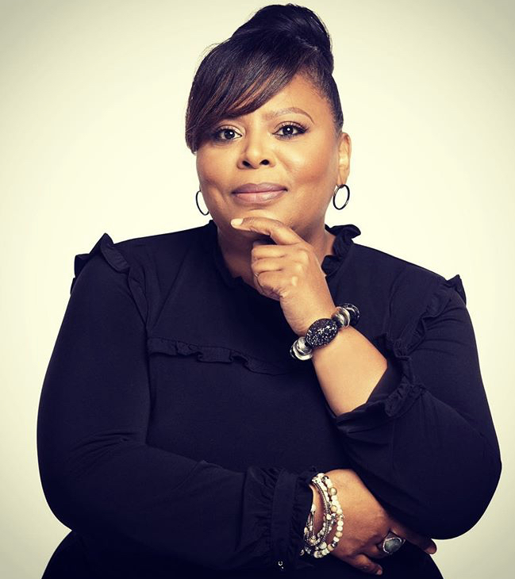
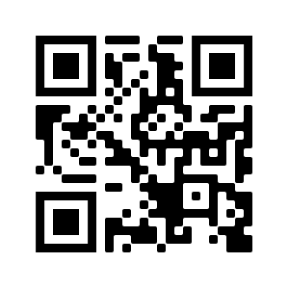
Connect and Contact
Dee Lockett
Web Developer | Marketing Maven | Difference Maker

Slide 3
Who to Target?
Find out everything you can about the person you serve or want to serve. Then find out some more.

Slide 4
What is the Revenue Goal?
How much money do you want to bring into your business? ”Without a vision the people perish.” Proverbs 29:18

Slide 5
When to Hire Help?
The answer is two-fold, when you can afford it. When you can’t afford not to.

Slide 6
Where Should I Spend Marketing Dollars?
Wherever your target customers are. Make your marketing follow them through their daily routine.

Slide 7
Ask Yourself Why?
The fundamental question that you must continue to ask yourself about money and marketing is why make, why spend, why serve.

Slide 8
How to Spend?
Spend your money on both digital and traditional ways of meeting your customer where they live, work, and play.

Slide 9
Connect and Contact
Dee Lockett
Web Developer | Marketing Maven | Difference Maker

