Slide 1
Michigan Celebrates Angels
April 20, 2021

Slide 2
It’s nice to meet you!
Notre Dame + Booth
Founded IrishAngels (angel network) in 2012
Founded Vitalize (fund) in 2017
We have invested ~$55M across 75+ companies to date
2x+ unrealized returns, 2 unicorns

Slide 3
VC Industry Trends

Slide 4
VC activity remains strong through pandemic, driven by mega rounds of $100M+
US VC Deal Activity
US VC Mega-Rounds ($100M+)

Slide 5
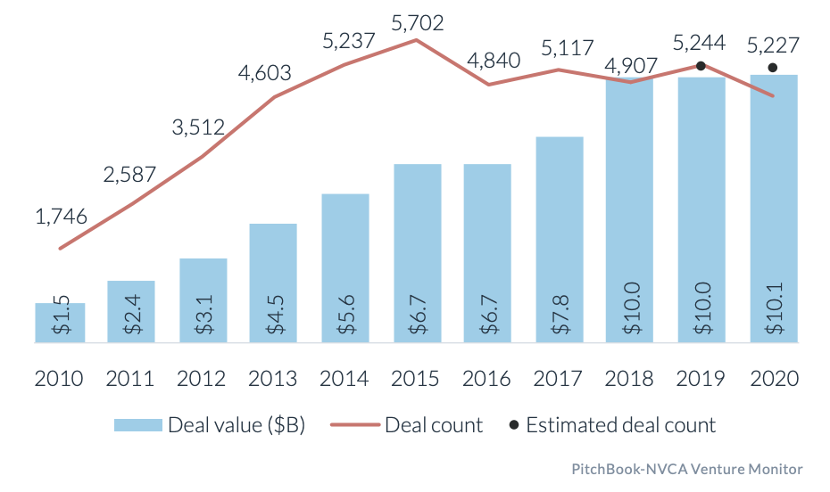
Early stage funding levels remained high in 2020, both in deal count and dollars
US Angel & Seed Deal Activity

Slide 6
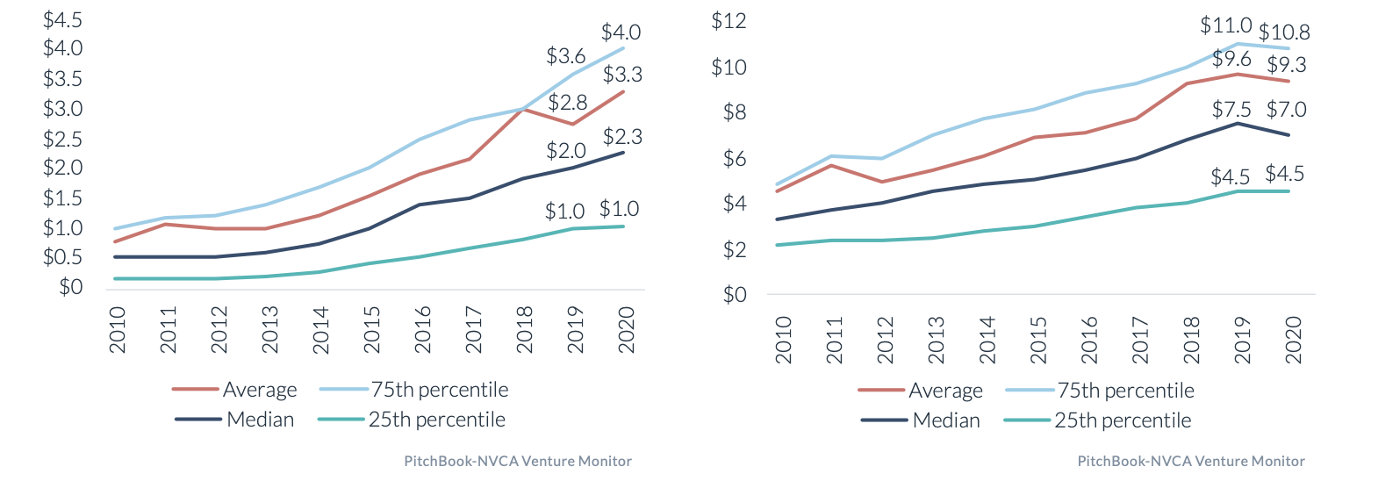
Seed rounds have gotten larger and valuation growth is finally stabilizing
US Seed Stage Deal Sizes ($M)
US Seed Stage Pre-money Valuations ($M)

Slide 7
VC-backed M&A had a pretty strong 2020, and IPOs had their best year in a decade
US VC-Backed M&A
US VC-Backed IPOs

Slide 8
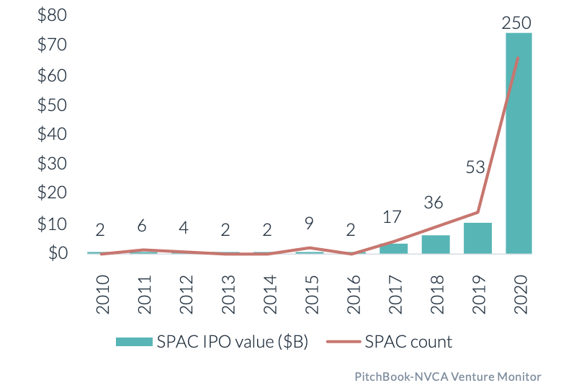
SPACS are on the rise, and new direct listing rules + secondaries market = liquidity options
US SPAC IPO Activity
SPACs are here to stay; this will be a preferred method for companies to go public
Direct listings now allow a concurrent capital raise and should grow in prominence
Secondaries markets are heating up; we expect new platforms to emerge

Slide 9
Early stage funding options are on the rise, creating competition & opportunity
Angellist rolling funds
Reg CF – Capital Raised by Year
Micro VC entrants
Crowdfunding
SPVs / syndicates
Venture partners / scouts
Family office directs
Source: 2019-2020 data from Kingscrowd. 2016-2018 data from Crowdfund Capital Advisors.

Slide 10
Our Michigan Portfolio

Slide 11
We have invested in 3 Michigan companies!
Kalamazoo
$1.5M investment across 2 rounds
Detroit
$360K across 2 rounds
Ann Arbor
$990K investment across 2 rounds

Slide 12
Q&A

