Slide 2
ABC's of SBIR/STTR: Program Goals, Eligibility: Is it for you?
April 27, 2021
Presenter:
Amanda Barnhart
Principal Consultant
amanda@bbcetc.com
bbcetc.com / @BBC_etc

Slide 3
About BBCetc
BBCetc works with technology-based entrepreneurs and companies on strategies to advance R&D efforts to commercialization. We are nationally recognized for our success in helping clients win federal funding through the SBIR/STTR programs and use it tactically to propel growth. Services include training courses and one-on-one counseling in:
Commercialization Planning
SBIR/STTR and Other Research Grant Assistance
SBIR/STTR and Commercialization Training
Grants/Contracts Management
Tech-Based Economic Development Programs
www.bbcetc.com / 734-930-9741 / @BBC_etc

Slide 5
Amanda Barnhart, MBA
Principal Consultant
Bachelor’s in Materials Science and Engineering, University of Michigan, Ann Arbor
Nuclear Engineer & Director of Business Development and Regulatory Affairs
$60 million in DOE, DHS, DoD, NIH, NSF and private investor funding
>30 SBIR/STTR awards
Executive MBA, Michigan State University
FDA, NRC, MI-LARA, DOT

Slide 6
SBIR/STTR Introduction & Overview Outline
SBIR/STTR Program Overview
Eligibility Requirements
Registrations
What you need to be competitive
SBIR vs STTR
Participating Agencies
How to choose the right agency

Slide 7
How well do you know the SBIR/STTR Program?
Notes:
How well do you know the SBIR/STTR Program?
I’m a pro. I’ve written/been awarded SBIRs before
Some knowledge or experience
What is SBIR?

Slide 8
What is the SBIR/STTR Program?
A ~$4 Billion+ Federal Funding Program
SBIR: Small Business Innovation Research
STTR: Small Business Technology Transfer
Support small business to:
Stimulate technological innovation to
Develop products with commercial merit
Create jobs
8
Notes:
Program been around since 1982
$100M SBIR, 3.2%
$1B STTR too, 0.45% (since 1992)

Slide 9
SBIR/STTR Program Overview
Small Business Innovation Research (SBIR): a set-aside program created by Congress in 1982 for small business concerns to engage in Federal R&D -- with potential for commercialization.
Small Business Technology Transfer (STTR): a set-aside program created by Congress in 1992 to facilitate cooperative R&D between small business concerns and U.S. research institutions -- with potential for commercialization.
3.2%
FY2018
0.45%
FY2018
Notes:
SR: Updated to reflect FY2016

Slide 10
What is SBIR/STTR?
Mandated by legislation
Reauthorized Oct 2017 for 5 years
Separate legislation for SBIR and STTR
Separate set-aside (3.2% for SBIR, 0.45% for STTR)
Applies to agencies with extramural research budgets that exceed certain thresholds
SBIR applicable to 11 Agencies
STTR applicable to 5 of the 11 SBIR agencies
Participation mandatory
SBA “oversees” program implementation and compliance
SBIR/STTR Policy Directive
Small Business Size Regulations
Notes:
Federal agencies with extramural research budgets over $100 million are required to set-aside a certain percentage of their budget to SBIR, and those with research budgets over $1 billion are required to set aside a portion of these funds for STTR.

Slide 11
11 Participating Federal Agencies
TOTAL: ~$3.7 B FY 2019
SBIR and STTR | SBIR Only
DOD - $1.8 B | USDA - $30 M
HHS - $1.15 B | DHS - $17 M
DOE - $308 M | DOC-NOAA - $9.5M
NSF - $212 M | ED - $8.4 M
NASA - $183 M | DoT – 5.2 M
 | DOC-NIST - $3.9 M
 | EPA - $3.6 M
Orange: Grant
Purple: Contract

Slide 12
Agency Differences
Receipt dates, number & timing of solicitations
Type of award (grant or contract)
Proposal review process
R&D topic areas
$ of award (both Phase I and II’s)
Proposal success rates
Gap funding provided (competing continuation grants)
Payment types & schedules

Slide 13
Why SBIR/STTR?

Slide 14
Funding for Commercialization
Debt
Equity
Non-Dilutive

Slide 15
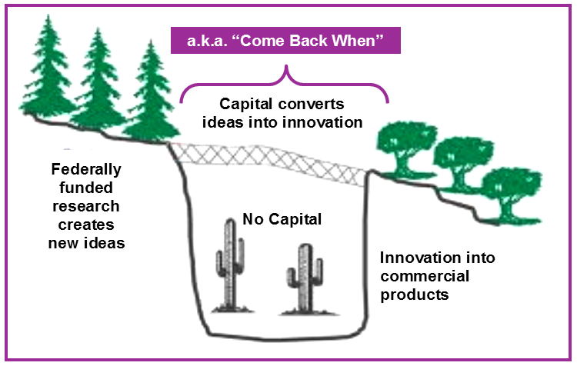
Goal of SBIR/STTR Programs
a.k.a. “Come Back When
Source: SBIR and the Phase III Challenge of Commercialization: Report of a Symposium. NAS, 2007.

Slide 16
Purpose of SBIR/STTR Programs
A Federal Funding Mechanism to:
Stimulate technological innovation in the private sector
Strengthen the role of small business in meeting Federal R&D needs
Increase commercial application of Federally-supported research
[Not an alternative source of funding basic research]

Slide 17
SBIR/STTR: Why?
Non-dilutive cash
Largest source of non-dilutive
Award helps validate technology
Can be used as leverage for investors
De-risk development
Enables early transfer of technology from academia to start-up companies
IP/Data Rights protection – New Rule: Government can’t share reports or data with anyone outside of the federal government for 20 years. Old rule 5 years (DoD) or 4 years (other agencies)

Slide 18
Compare and Contrast
SBIR / STTR
9 months to funding
10% - 20% success rate
Don’t need to know anyone
Will fund early stage R&D
Non-dilutive
Don’t take board seat
$3 billion per year available
Peer review
Venture Capital
6-12 months to funding
<1% probability
Need to know someone
Unlikely to fund early stage
Take equity (sometimes lots)
Take a board seat (and sometimes control)

Slide 19
SBIR/STTR: 3-Phase Competitive Program
PHASE I Feasibility Study
Award Guideline: $150K … varies by Agency … can rise to $256,580K
Duration: 6 months (SBIR)/12 months (STTR)
PHASE II Full Research, R&D to Prototype
Award Guideline: $1M (SBIR)/$1M (STTR) … varies by Agency … can rise to $1.71M, or more with waiver
Duration: 2 years
PHASE III Commercialization
Subsequent investment to achieve commercialization, or sale
Use of non-SBIR/STTR Funds

Slide 20
The Basics of SBIR: 3 Phases
2.5 - 3 Years, ~$1.15M to $1.97M
Phase I:
6-12 Months, $150K-~256K
Phase II:
2 Years, ~$1M to ~1.71M
Phase III: Commercialization (no federal SBIR/STTR $$)
Beware of the gap between phase I and II

Slide 22
You must have a small business
For-profit
US-owned and controlled
> 50% owned by U.S. citizens or permanent residents
< 500 employees
Located in the U.S.
R&D for grant project must be performed in the U.S.
Company-controlled research space for grant project
Notes:
At least 51% owned and controlled by US citizens or permanent residents and/or one or more domestic concerns that are 51% or multiple domestic VCOC (venture capital operating companies), HF (hedge funds), PEF (private equity funds) provided no single investor is more than 50%

Slide 23
SBIR & STTR Size Regulations
Ownership and Control
>50% owned and controlled by:
US citizens, permanent resident aliens and/or one or more domestic business concerns which themselves are >50% owned and controlled by US Citizens or permanent resident aliens
or
Multiple domestic VCOCs, HFs, or PEFs, provided that no single such investor owns more than 50% (SBIR ONLY)

Slide 24
What will make you ineligible for the SBIR/STTR Program?
Notes:
What will make you ineligible for the SBIR/STTR Program?
Being organized as a not-for-profit company
Being a brand new startup
Having no investors
Having 499 employees

Slide 25
Registrations
Allow a minimum of six weeks to complete all registrations

Slide 26
Registrations Required by Agency
Registration Type | Agency
 | NIH | DoD | NSF | NASA | DoE | USDA | DoT | EPA | DoC | DoEd | DHS
EIN | X | X | X | X | X | X | X | X | X | X | X
DUNS | X | X | X | X | X | X | X | X | X | X | X
SBIR.gov (company registration)* | X | X | X | X | X | X | X | X | X | X | X
SAM (System of Award Management) | X | X** | X | X | X | X | X | X | X | X | X
Grants.gov | X |  |  |  | X | X |  |  |  | X
eCommons | X
FastLane / Research.gov |  |  | X
DoD’s sbir.defensebusiness.org |  | X
PAMS (DOE Portfolio Analysis & Mgmt System) |  |  |  |  | X
ASAP |  |  |  |  | X
FedConnect |  |  |  |  | X |  |  | X
EHB (Electronic Handbook) |  |  |  | X
*SAM registration is not required to complete SBIR.gov registration
**DoD does not require SAM registration until time of award but encourages it before submission
For registration links, visit BBC’s website:
http://bbcetc.com/capabilities/sbir-sttr-research-grant-assistance/registration-help/

Slide 27
Registrations
All organizations submitting SBIR/STTR proposals to any Agency must have the following:
EIN – Employer Identification Number (IRS)
DUNS – Data Universal Number (D&B)
SAM – System for Award Management * (U.S. Gov’t)
SBIR.gov – Company registry specific for SBIR/STTR (SBA)
*DoD requires SAM at time of award

Slide 28
What is an EIN Number?
Federal Tax Identification Number
An Employer Identification Number (EIN) is also known as a Federal Tax Identification Number
Used to identify a business entity.
This is a free service offered by the Internal Revenue Service.
https://www.irs.gov/businesses/small-businesses-self-employed/apply-for-an-employer-identification-number-ein-online

Slide 29
Registrations – DUNS #
What is it?
Data Universal Number System (DUNS)
FREE unique 9 digit id number for your organization
Where do I get it?
Dun & Bradstreet at https://fedgov.dnb.com/webform/
Use the page for US Federal Government Contractors and Grantees
Why?
The federal government has adopted the use of DUNS numbers to track how federal grant money is allocated.
How long will it take?
Same Day. You will receive DUNS # information online.
Notes:
Once you have received your EIN number you can apply for a DUNS number.
DUNS is the Data Universal numbering systems, used by the federal government to track how federal grant money is allocated. Usually the number is issued on the same day as applied. Again be consistent with the information you are entering. If the company is listed on the IRS record (EIN) as ACME, LLC then it needs to be ACME, LLC at DUNS. The registrations sites use a digital review and if something as small as a comma is not included it can kick the registration out.

Slide 30
System for Award Management
What is SAM?
https://www.sam.gov/SAM/
SAM is a federal government-owned and operated free web site that combines several procurement systems and the Catalog of Federal Domestic Assistance into one common system.
Central Contractor Register (CCR)
Federal Agency Registration (Fedreg)
Online Representation and Certifications Application (ORCA)
Excluded Parties List System (EPLS)

Slide 31
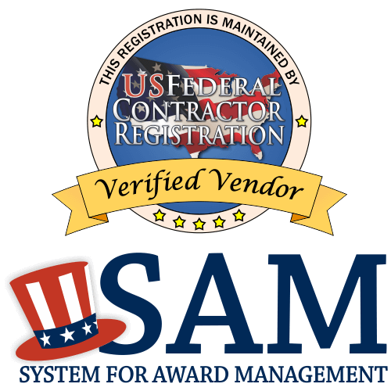
SAM Registration
What do I need?
You need an EIN and DUNS number to register at SAM
Company name, address, entity
Name, address, phone, email of POC
Checking account and bank information
Commercial account
EFT contact person/email
Company annual revenue – estimates
NEW in 2018: Notarized Letter
Notes:
There are a series of questions that need to be answered. Including company name address, entity. Etc.

Slide 32
SAM – Notarized letter
An original signed notarized letter must be provided if:
The entity is registering for the first time
The entity is renewing the registration
The letter must be:
on the entity’s letterhead
must state that the organizational official registering the organization is the authorized Entity Administrator
Must be submitted within 30 days of registering

Slide 33
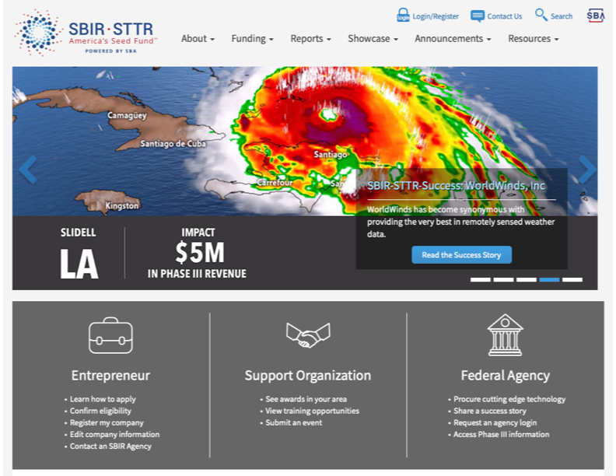
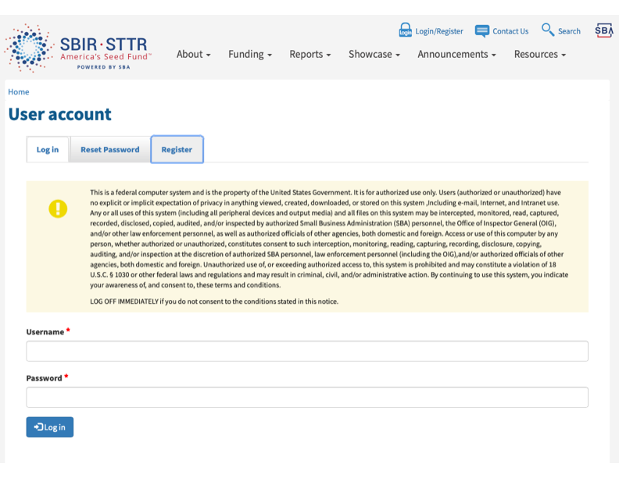
SBIR.gov
www.sbir.gov
Notes:
The process is simple. Go to SBIR.gov,

Slide 34
5. Registration Finished

Slide 35
Registration—Tips for Success
Begin at least 6 weeks before the deadline
Log in to accounts prior to deadline to check your access
Update System for Award Management (SAM) information annually
Maintain a centralized record of all logins, passwords and emails associated with each registration
DO NOT PAY FOR ANY REGISTRATION!

Slide 36
In order to apply for an SBIR you need…
A small business
An address
A company bank account

Slide 37
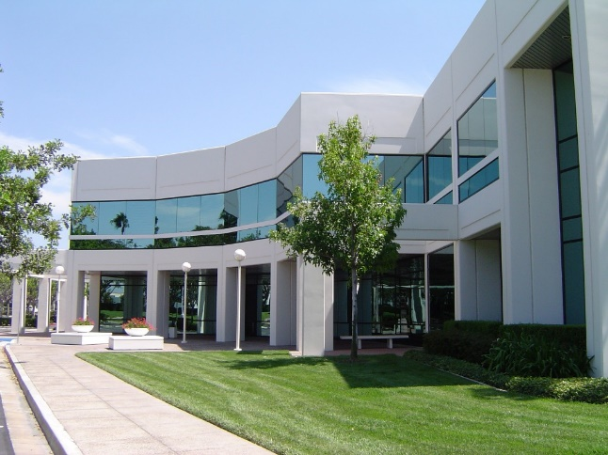
In order to receive an SBIR/STTR Award…
People
Facilities
Other Resources

Slide 38
Project Team
All the expertise required for project success
Well-defined roles
Well-defined scope
Complementary skills
Other employees
Advisors
Consultant
Principal Investigator
Sub- contractor

Slide 39
You Need a Project Team
Company Employees*
Domain expertise
Senior personnel
Other personnel
Independent Consultants
Specialized expertise
Subcontractors
Employees of another company/institution
Advisors
May or may not be compensated
Available “as needed”
* A Just in Time (JIT) requirement
Notes:
Employees – senior vs. non-senior
Example of advisor – Univ professor (founder/advisor) not on project team
Use of Univ facility & equipment
Commercialization expertise

Slide 40
You Need a Principal Investigator
For an SBIR the PI MUST be employed by the small business and have 50% of their professional effort at the small business.

Slide 41
You Need Company Facilities*
The research work to be performed by the awardee is to be conducted in:
Company-controlled
Research space
Suitable to do the work proposed
Some work may be done in other facilities
* A Just in Time (JIT) requirement

Slide 42
No Virtual Companies!

Slide 43
You Need Other Resources
Other R&D Resources
Scientific Advisory Board
Commercialization/Business Resources
Company Management
Strategic Partners
Other funding/investors
Regulatory/Reimbursement guidance
Company Management Team
Community Support

Slide 44
You must have a Project

Slide 45
The Project
What Does SBIR/STTR Fund?
Product Development
Based on Technological Innovation
Credible Commercialization Strategy

Slide 46
The Project
Based on technological innovation:
Define the innovation
Is there risk of failure?
Will the product be revolutionary or evolutionary?
Not for commercializing technology that has already been developed, or one with low risk that only needs capital

Slide 47
You must have a Product

Slide 48
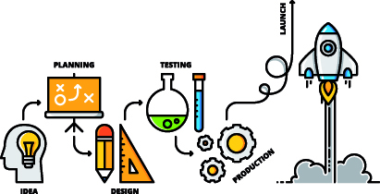
There must be a Product
SBIR is always Product Development
Intended use
Problem it is solving
End-user - customer
Preliminary work
Remaining development

Slide 49
You must have Commercial Potential

Slide 50
The Project
What is Commercialization?
Ability to provide a solution to a problem in exchange for money
Important Problem?
Viable Business Model?

Slide 51
The Planning Process
Describe the problem
Identify the “target” customer
Define the market (e.g., size, growth rate, distribution)
List alternative solutions (i.e., competition)
Define the “value proposition”
Describe the business model
51
Notes:
What is commercialization?:
Ability to provide a solution to a problem in exchange for money
Important Problem
Targeted and Differentiated Solution
Viable Business Model

Slide 52
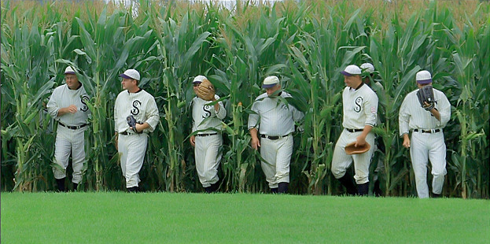
Commercialization
There is no such thing as the “Build it and they will come” Business Model

Slide 53
Most Common Pitfall
 | Year 1 | Year 2 | Year 3 | Year 4
Product Development
Business Development
Naïve Planning process
Product Development and Business Development go hand in hand
Knowing your customer helps develop both simultaneously
 | Year 1 | Year 2 | Year 3 | Year 4
Product Development
Business Development
53
Notes:
Incorporate so that there is good product-market fit down the line so you don’t develop a product that nobody wants.

Slide 54
Intellectual Property Protection
Current status of IP
IP strategy
How will you protect it
Freedom to Operate
Opportunities for IP as a result of this proposal
How will your use your IP to implement your commercialization strategy
54

Slide 55
“Rights” to Commercialize
If you are an academic or employed elsewhere:
READ and KNOW your institution’s Intellectual Property Rights Policy
Assume the institution owns the IP unless proven otherwise
Beware of public disclosure
Beware of conflict of interest issues
Transfer is based on negotiation and a viable business opportunity
55

Slide 56
Four Bodies of Law
Patenting Considerations for SBIR Awardees
Patent law
SBIR data right provisions
Trade Secret law
The Bayh-Dole Act
Notes:
https://www.jdsupra.com/legalnews/patenting-considerations-for-sbir-2074436/
From an intellectual property perspective, the SBIR program is situated at the intersection of the following four bodies of law:
Patent law – in general, provides you with rights and remedies to exclude others from practicing your patented inventions;
SBIR data rights provisions – in general, provides you with rights and remedies against the government if it improperly shares your properly marked SBIR data;
Trade secret law – in general, provides you with rights and remedies against others who misappropriate your trade secrets; and
The Bayh-Dole Act – in general, imposes certain requirements on companies that receive federal funding for research and development.
Each of these bodies of law informs whether and when SBIR awardees should file patent applications or, in the alternative, rely on secrecy to protect their technology.

Slide 57
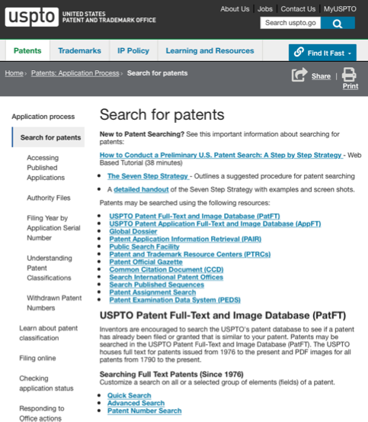
Patent Search
https://www.uspto.gov
57
Notes:
USPTO moved office to Detroit. Tons of webinars and everything is free. Elephant in the room and a great resource that people should
SBDC tech team has licensed and done patent searches at no cost. Just need to book an appointment with them.
Do before spending money with an attorney. Likely similar resources in other areas than just Michigan. Reach out to LSW who can tell them resources.

Slide 58
SBIR Data Rights
Applies to ALL Phase I, II, and III Awards
Government cannot disclose
20-year period from date of award
Basic attributes
Recorded
Technical
Generated under SBIR/STTR agreement
Notes:
https://www.jdsupra.com/legalnews/patenting-considerations-for-sbir-2074436/
SBIR data rights, meanwhile, generally prohibit the government from externally disclosing properly marked data developed in the performance of an SBIR award. Specifically, the government is prohibited for a period of 20 years from externally sharing this information for procurement, manufacturing, or commercial purposes, but there are other limited purposes for which the government can share the protected information. See SBIR Policy Directive, 84 Fed. Reg. 12794, 12846 (April 2, 2019).
One of the most important of these protections is that the government cannot disclose SBIR Data outside of the government.
The government receives a limited nonexclusive license, or right to use, SBIR Data, but such use cannot include disclosing it in any way. This nondisclosure obligation is accompanied by a Data Rights protection period. In its May 2, 2019 SBIR/STTR Policy Directive, SBA changed the Data Rights protection period for both SBIR and STTR funding agreements to a uniform 20-year period that begins on the date of award. This start date for the protection period is new, as is the 20-year period. The protection period no longer begins on the date of delivery of the last funding agreement deliverable. In exchange for the grant of the 20-year protection period, SBA eliminated the extension or “roll-over” provision, effective May 2, 2019. Thus subsequent SBIR/STTR funding agreements no longer extend data protection periods for prior awards to the end of the protection period that applies to the current award. The 20-year protection period applies both to SBIR and STTR awards. Keep in mind that a Phase III award is by definition not paid for with Phase I or II SBIR/STTR funding. To get the most out of your participation, it is important that you re-align your marketing schedule to this new 20-year protection period for each award.
These SBIR/STTR Data Rights protections have many implications. First and foremost, this nondisclosure obligation means that the government cannot compete technologies containing SBIR Data. Any such competition would mean disclosing the SBIR Data in solicitations, which the government cannot do. This unique right also underlies and supports the sole source Phase III mandate – the requirement to award Phase III awards to the SBIR developing firm to the greatest extent practicable. This single right – and obligation of the government – creates value in the SBIR firm and ultimately wealth for the SBIR owners.
Because of the importance of SBIR/STTR Data in the new program, it is vital for small businesses to understand the nature of SBIR Data and how to protect it. It is important to understand what SBIR Data is, as well as what it is not – so that SBIR owners and their employees can better protect their technologies and SBIR Data. As we go through this analysis, one can quickly see that the SBA Directive treats SBIR and STTR Data alike.
SBIR/STTR Data has three basic attributes: 1) it is recorded information, 2) of a technical nature, 3) that is generated under an SBIR or STTR funding agreement and appropriately marked with the SBIR/STTR Data Rights legend. We use the term “funding agreement” because SBIR awards can be grants, contracts, cooperative agreements, or any other type of funding award the government chooses to make.

Slide 59
Bayh-Dole Act (1980)
Allows recipients of Federal funding to elect right and title to inventions
Contracts, grants, and cooperative agreements
Stimulate economic growth and commercialization of Federally-funded inventions
Disclose “subject inventions” to government
Provides government a royalty-free license
Notes:
In the 1970s $75 billion spent per year in gov’t sponsored R&D
Federal gov’t held approximately 28,000 patents
Fewer than 5% of those we licensed to industry for development/commercial products
Companies did not have exclusive rights and therefore were reluctant to invest→ taxpayers were not benefitting from their contributions
Bayh-Dole permitted universities and small businesses to elect ownership of inventions made under federal funding and to become directly involved in the commercialization process
https://www.jdsupra.com/legalnews/patenting-considerations-for-sbir-2074436/
The Bayh-Dole Act imposes a number of requirements on companies that receive federal funding for research and development, and SBIR awardees should consult with a qualified attorney to ensure that they are complying with its requirements. Two provisions are of particular importance for SBIR awardees to consider as they plan their intellectual property strategies. First, the Bayh-Dole Act requires recipients of federal funding to disclose “subject inventions” to the government, make a written election as to whether they will retain title, and, if the recipient elects to retain title, timely file a patent application or risk forfeiture of the rights to those inventions. 35 U.S.C. § 202(c)(1)-(3). “Subject invention” is defined as “any invention of the contractor conceived or first actually reduced to practice in the performance of work under a funding agreement.” 35 U.S.C. § 201(e). Second, the Bayh-Dole Act provides the government a royalty-free license to practice or have practiced on its behalf any subject inventions. 35 U.S.C. § 202(c)(4).

Slide 60
Practical Implications
Timely disclose invention, elect title, and file patent application in accordance with Bayh-Dole Act
SBIR data rights may be more effective
Partition private-expensed inventions from SBIR-funded inventions
Intersection of SBIR data rights and Bayh-Dole Act
Notes:
The combination of these rules has a number of practical implications.
First, SBIR awardees who wish to patent an invention that was conceived or first reduced to practice in the performance of the SBIR award should timely disclose the invention, elect title, and file a patent application in accordance with the provisions of the Bayh-Dole Act and any applicable terms in a funding agreement. Failure to do so can result in forfeiture of the rights to the patent(s) on the invention.
Second, for companies that are interested in selling primarily to the government, SBIR data rights may be more effective in preventing the government from sharing your technology with your competitors than are patents directed to “subject inventions.” This is because an issued patent or published patent application is public information as to which any nondisclosure obligations may be relinquished, and, if the patent is directed to a “subject invention,” the government is entitled to have the patented technology practiced on its behalf. 35 U.S.C. § 202(c)(4); see also 37 C.F.R. § 401.14. The government is prohibited, however, from sharing nonpublic, properly marked SBIR data for procurement, manufacturing, or commercial purposes within the 20-year protection period. SBIR Policy Directive, 84 Fed. Reg. at 12846.
Third, to maximize your rights, you may wish to take steps to partition the inventions you develop at private expense from those that are conceived or first reduced to practice in the performance of an SBIR award. For example, you may consider filing a patent application before you submit an SBIR proposal or begin work under an SBIR award so that you can demonstrate that the disclosed technology was not conceived with government funding (this may also beneficially reduce the risk that technical information in your SBIR proposal will become public and be treated as prior art against your patent applications). You may also consider reducing to practice the technology for the first time outside the scope of the SBIR award—such as by reducing the technology to practice before beginning work under the SBIR award, or by using only private funds for this effort. Together, these steps may reduce the likelihood that your privately developed technologies will be treated as “subject inventions” as to which the government is entitled to a royalty-free license.
Fourth, if you plan to sell to the government, consider speaking to an attorney about the intersection of SBIR data rights and the Bayh-Dole Act before reporting SBIR technical data to the government as a “subject invention.” If you conclude that the SBIR technical data does, in fact, constitute a “subject invention,” you may also consider speaking to your attorney about whether to file the patent application with a nonpublication request so that the SBIR data rights protection period may be extended until the patent issues.
https://en.wikipedia.org/wiki/Bayh%E2%80%93Dole_Act
A subject invention is defined as "any invention of the contractor that is conceived or first actually reduced to practice in the performance of work under a funding agreement."^{[23]}
The CFR addresses the relationship between federal funding and other funding that may supplement the federally supported research. If an invention is made outside the research activities of the federally funded research "without interference with or cost to the government-funded project," then the invention is not a subject invention. Similarly, an invention is not a subject invention if it arises in closely related research outside the "planned and committed activities" of the federally funded project, and the closely related research does not "diminish or distract from the performance" of the federally funded project.^{[24]}

Slide 61
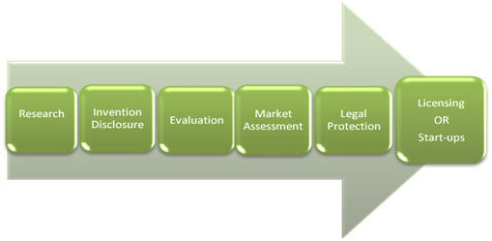
Commercialization: Phase I v Phase II
Varies somewhat by Agency
e.g. More for NSF than NIH in Phase I
Phase I = Commercial justification
Phase II – Commercialization Plan

Slide 62
Exit Strategy
Initial public offerings (IPOs)
Strategic acquisitions
Management buyouts
Notes:
the way most entrepreneurs answer the question:
"I plan to sell in 10 years," she always says.
It is the same answer she has given me since 1997.
And I also not looking for the general "I will sell answer" unless it is accompanied by a level of specificity. ("I am going to do an ESOP; I plan on taking the company public; I will help my employees do a leverage buy out." That sort of thing.)
A business exit strategy is a plan that a founder or owner of a business makes to sell their company, or share in a company, to other investors or other firms.
Initial public offerings (IPOs), strategic acquisitions, and management buyouts are among the more common exit strategies an owner might pursue.
If the business is making money, an exit strategy lets the owner of the business cut their stake or completely get out of the business while making a profit.
If the business is struggling, implementing an exit strategy or "exit plan" can allow the entrepreneur to limit losses.

Slide 63
Know the Difference between SBIR & STTR

Slide 64
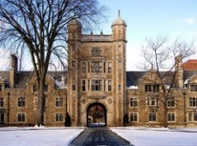
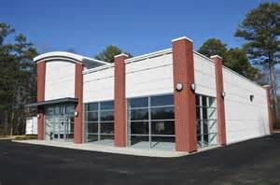
SBIR vs. STTR
Relationship with a non-profit research institution:
SBIR allows but does not require the involvement of a non-profit research institution
STTR requires the involvement of a non-profit research institution
The Applicant/Awardee is always the Small Business.

Slide 65
SBIR vs. STTR: Who does the work?
‘Outsourcing’ limits:
SBIR: < 33% in a Phase I and 50% in a Phase II
STTR: > 40% at small business and > 30% at partner non-profit research institution
The applicant is always the small business

Slide 66
SBIR vs. STTR: Where is the PI?
Principal Investigator rules:
SBIR: PI at least 51% employed at small business
STTR: At small business or non-profit research partner. Must have an ‘official relationship’ with the small business and at least 10% effort on the project*
*NSF-PI must be at SBC

Slide 67
If you are at a University…
Remember to consider:
Intellectual Property Policy
Invention disclosure
Consulting opportunities
Conflict-of-interest policy
Communicate with Tech Transfer

Slide 68
SBIR vs. STTR
SBIR | STTR
Applicant is ALWAYS the Small Business Concern (SBC)
Allows outsourcing* | Requires outsourcing* 1˚ subcontractor must be a non-profit research institution
Maximum outsourcing limits ≤ 33% of Phase I ≤ 50% of Phase II | Minimum participation requirements ≥ 40% by SBC ≥ 30% by SBC 1˚ subcontractor
PI must be employed by SBC > 50% of full time equivalent | PI may be employed by SBC or 1˚ Subcontractor > 50% of full time equivalent ≥ 10 % effort on project
Company MUST have “company-controlled R&D facilities suitable to do work proposed”
*outsourcing includes work done by subcontractors and consultants

Slide 69
How do you choose ?
Does the agency offer STTR?
Conduct a needs based resource inventory
People, experience & expertise
Facilities
Equipment
Budget constraints
Talk to the Agency – Program Officer

Slide 70
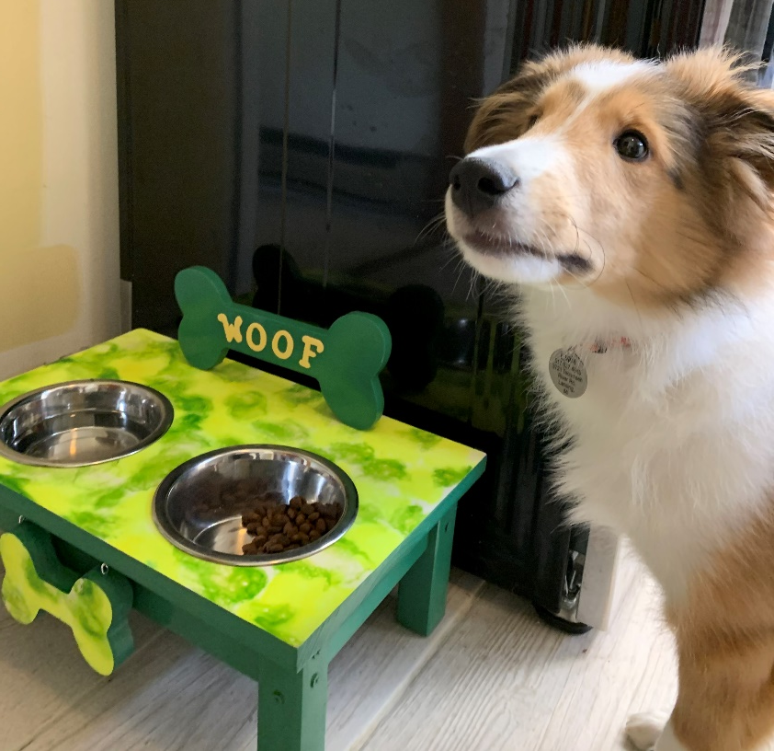
True or False?
A full-time university professor can be PI of an SBIR.
Notes:
True or False? A full-time university professor can be PI of an SBIR.
True
False

Slide 71
Finding a home for your project

Slide 72
Choosing your agency

Slide 73
Agency Differences -- Grants vs. Contracts
Grants – Investigator Initiated Topics
HHS (95% $$), NSF, USDA, DOE, ED
Some agencies might have topic areas (aka “buckets”)
Open communications
External peer review
Contracts – Agency-specified topics
DoD, NASA, DHS, EPA, DOT, DOC, ED, HHS (5% $$)
Must respond to a topic
Limited time to prepare ( 8-12 weeks)
Limited communications during open solicitation
Internal review

Slide 74
Contracts versus Grants
Contracting Agencies | Granting Agencies
Agency establishes requirements Highly focused topics Procurement mechanism More fiscal requirements Invoiced on Progress, Deliverables DoD, DHS, NASA, EPA, DOT | Investigator initiates approach Broad topics Assistance mechanism Budget more flexible Progress/final reports NSF, DoE, USDA
Contracting and Granting Agencies: HHS/NIH, DOC, ED

Slide 75
The Big Questions
How do I find the right Agency?
How do I find the right topic?

Slide 76
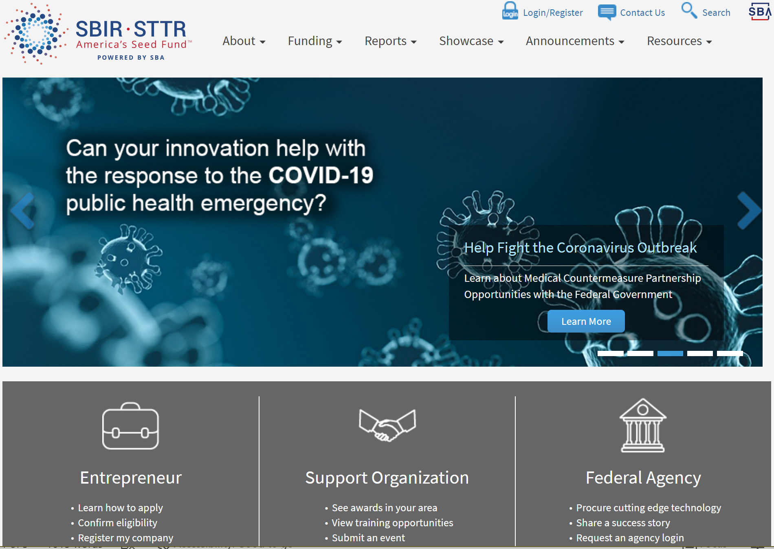

Slide 77
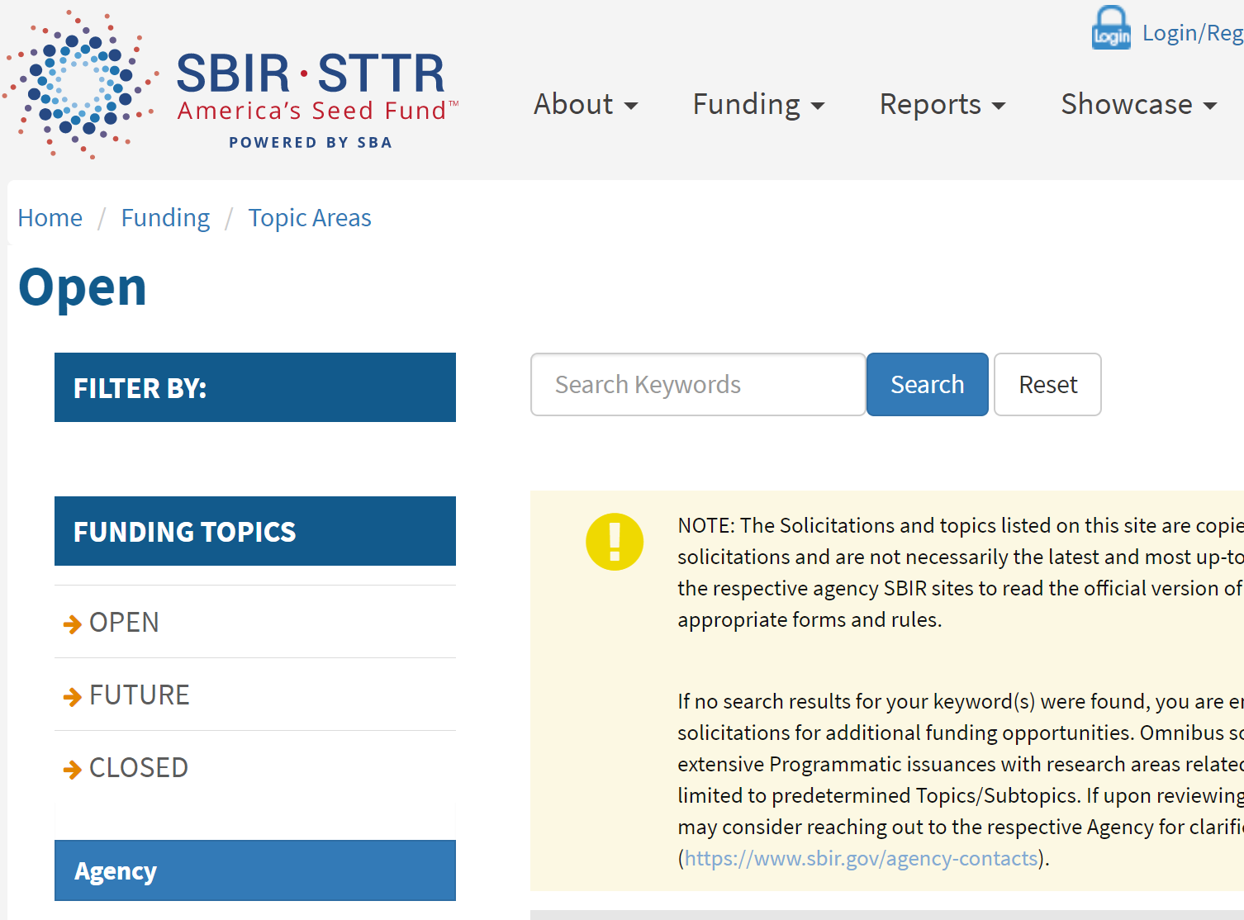

Slide 78
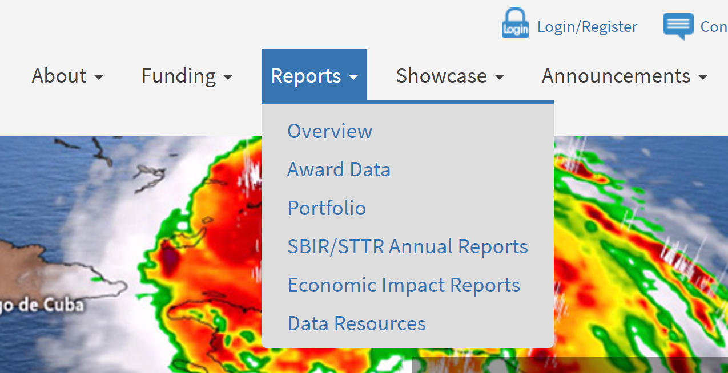
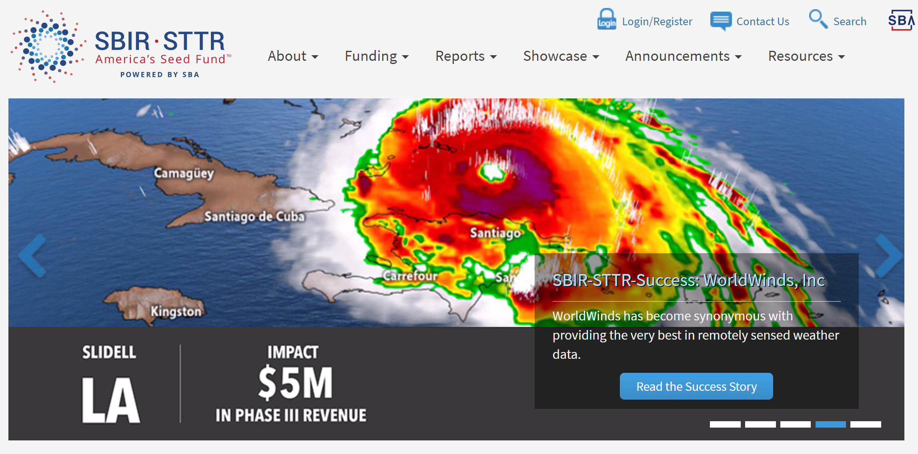

Slide 79
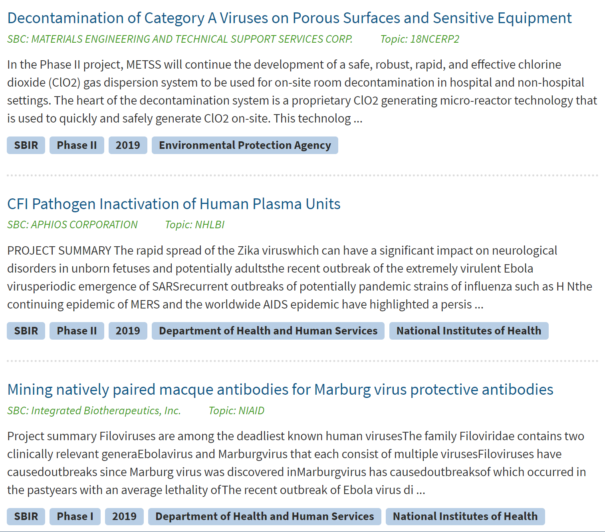
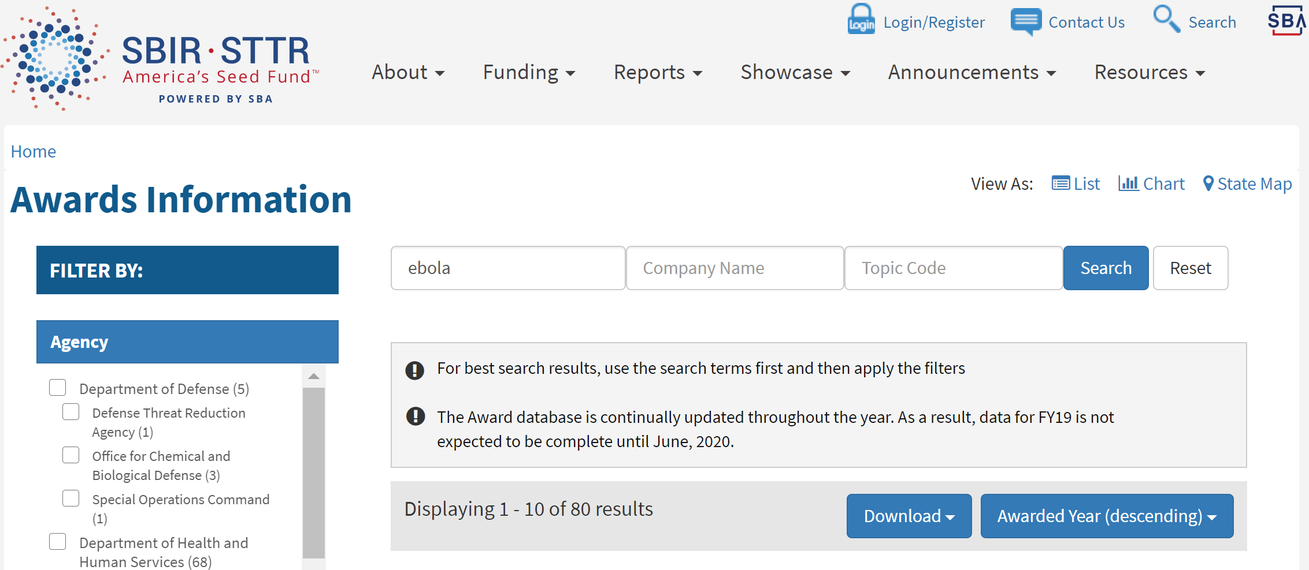

Slide 80
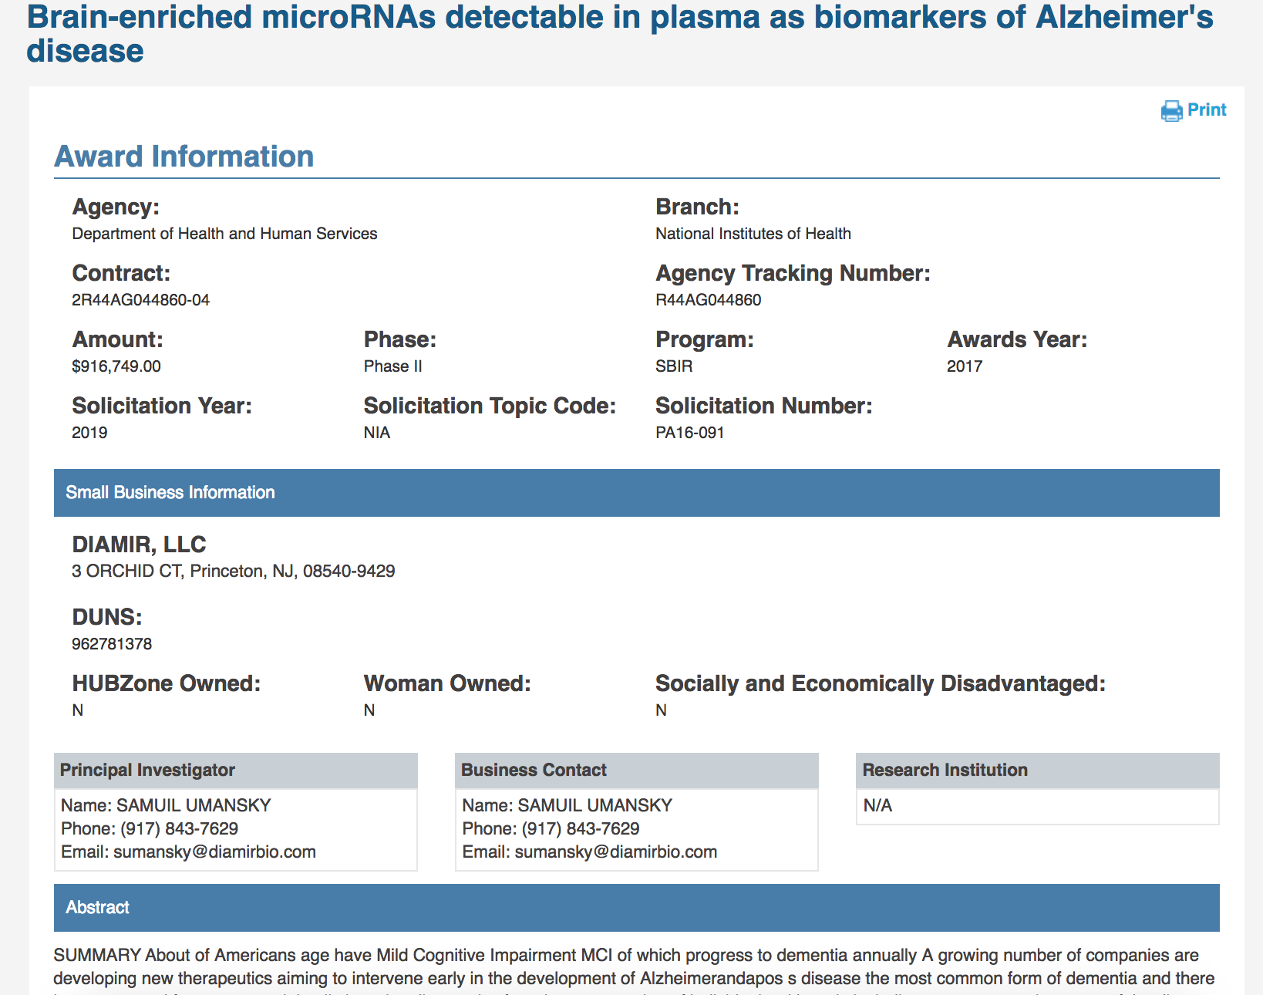

Slide 81
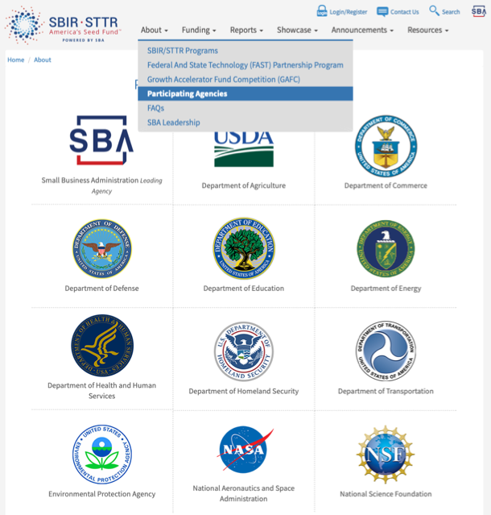
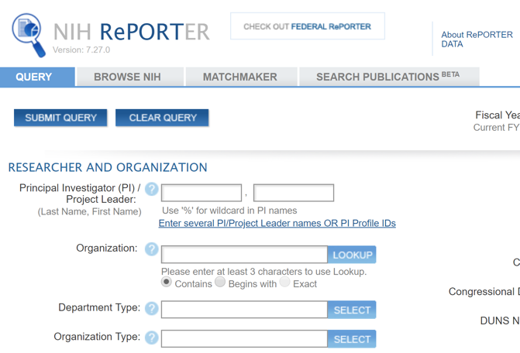
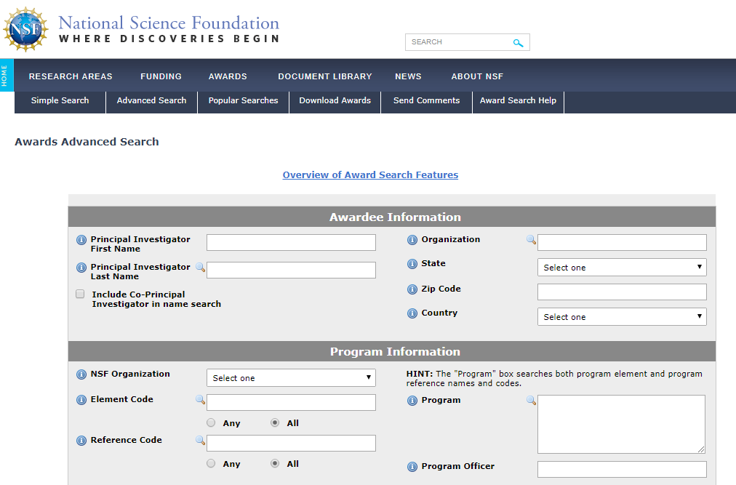
Every Federal Agency has its own searchable Database
SBIR.gov Links

Slide 82
Number of Solicitations Annually
Agency |  | SBIR | STTR
Defense | DOD | 3 | 3
Health & Human Services* | HHS | 3 | 3
Energy | DOE | 2 | 2
National Science Foundation | NSF | 2 | 2
NASA | NASA | 1 | 1
Agriculture | USDA | 1 | N/A
Homeland Security | DHS | 2 | N/A
Education | IES | 1 | N/A
Transportation | DOT | 2 | N/A
Commerce | NIST | 1 | N/A
 | NOAA | 1 | N/A
Environmental Protection | EPA | 1 | N/A
82
*refers to Omnibus solicitations review cycles; doesn’t include special PAs/RFAs

Slide 83
Examples of Phase I Proposal Requirements
 | SBIR/STTR
Agency | Proposal | Commercial Section
Department of Defense | <20 page | 1 page
Health & Human Services | <7 pages | ½ page
Department of Energy | <15 pages | <4 pages
NASA | <23 pages | ½-1 page
National Science Foundation | <15 pages | 4 pages (Ph I) 15 pages (Ph II)

Slide 84
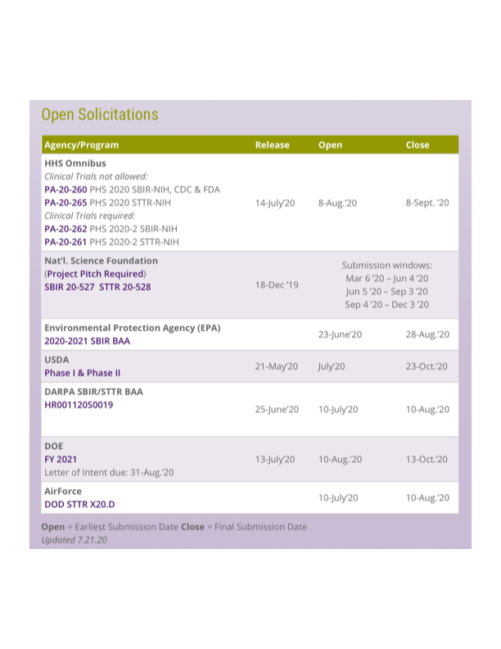

Slide 85
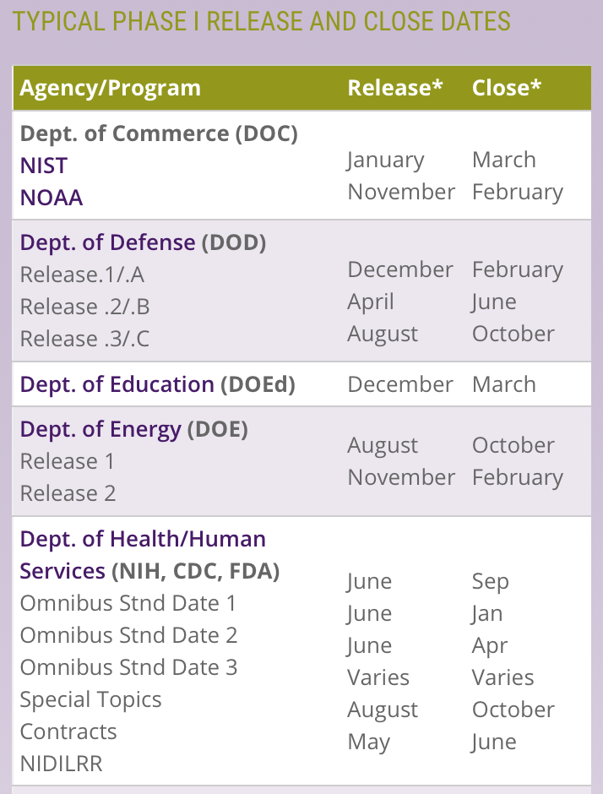
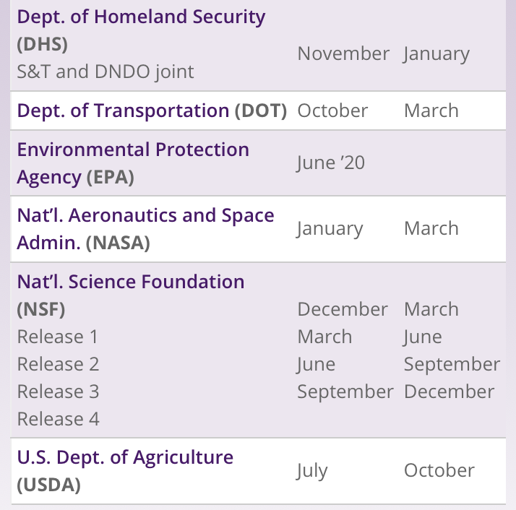
85

Slide 87
Working with BBCetc

Slide 88
In < minutes
answer just
questions
And let us know how we did!
http://bit.ly/sbirgrants

